Slide 1
Natural Language Processing IST 664/CIS 668
Week 4 Lectures
POS Tagging & Introduction to Machine Learning
1

Slide 2
Natural Language Processing IST 664/CIS 668
Week 4 - Readings
Jurafsky and Martin, Speech and Language Processing, 3rd edition. Read sections 8.1 – 8.3: Chapter 8, Part-of-Speech Tagging.
From the NLTK book, Chapter 5: Categorizing and Tagging Text
Skim sections 1. Using a Tagger, 2. Tagged Corpora, 3. Python Dictionaries.
2

Slide 3
Natural Language Processing IST 664/CIS 668
Week 4 - Resources
To see the results of POS tagging, go to the parsing demo page of the Stanford parser.
Also at the Cognitive Computation Group at the University of Pennsylvania.
3

Slide 4

Part-of-Speech (POS) Tagging: Introduction

Slide 5
Levels of Language
POS tags are assigned to words but may be determined by adjacent words.
Pragmatic Discourse
Semantic
Syntactic Lexical
Morphological

Slide 6
What Is Part-of-Speech Tagging?
The general purpose of a part-of-speech tagger is to associate each word in a text with its correct lexical-syntactic category (represented by a tag).
­ Example using tags from the Penn Treebank POS tag set
03/14/1999 (AFP)… the extremist Harkatul Jihad group, reportedly backed by Saudi dissident Osama bin Laden…
… the|DT extremist|JJ Harkatul|NNP Jihad|NNP group|NN,|, reportedly|RB backed|VBD by|IN Saudi|NNP dissident|NN Osama|NNP bin|NN Laden|NNP…

Slide 7
What Are Parts of Speech?
They are approximately eight traditional basic word classes, sometimes called syntactic classes or types.
These are the ones taught in grade school grammar.
­ N | noun | chair, bandwidth, pacing
­ V | verb | study, debate, munch
­ ADJ | adjective | purple, tall, ridiculous (includes articles)
­ ADV | adverb | unfortunately, slowly
­ P | preposition | of, by, to
­ CON | conjunction | and, but
­ PRO | pronoun | I, me, mine
­ INT | interjection | um
For example, see the shows from Schoolhouse Rock on grammar.

Slide 8
Open and Closed Classes of Words
Open classes—can add words to these basic word classes:
­ Nouns, verbs, adjectives, adverbs
­ Some kinds of numbers
­ Every known human language has nouns and verbs
­ Open class words are more often borrowed from one language to another
Closed classes—words are not added to these classes:
­ Determiners, pronouns, prepositions, particles, auxiliary verbs
­ Closed-class words are often function words that have structuring uses in grammar
­ Differ more from language to language than open-class words

Slide 9
Open and Closed Classes
We may want to make more distinctions than eight classes.
Open class (lexical)
Nouns
Verbs
Adjectives
old older oldest
Proper
IBM
Italy
Common
cat/cats snow
Main
see registered
Adverbs slowly
Numbers
122,312
… more
Closed class (functional)
one
Modals
can had
Determiners the some
Prepositions
to with
off up
Ow Eh
Conjunctions
and or
he its
Particles
… more
Pronouns
Interjections

Slide 10
POS Tag Sets

Slide 11
Possible Tag Sets for English
Kucera and Francis (Brown Corpus)—87 POS tags C5 (British National Corpus) —61 POS tags
­ Tagged by Lancaster’s UCREL project
Penn Treebank—45 POS tags
­ Most widely used of the tag sets today

Slide 12
Penn Treebank
A corpus containing:
­ Over 1.6 million words of hand-parsed material from the Dow Jones News Service, plus an additional 1 million words tagged for part of speech.
­ The first fully parsed version of the Brown Corpus, which has also been completely retagged using the Penn Treebank tag set
­ Source code for several software packages that permits the user to search for specific constituents in tree structures
Costs $1,250 to $2,500 for research use Separate licensing needed for commercial use

Slide 13
Word Classes: Penn Treebank Tag Set
Tag | Description | Example | Tag | Description | Example
CC | coordinating conjunction | and, but, or | SYM | symbol | +, %, &
CD | cardinal number | one, two, three | TO | “to” | to
DT | determiner | a, the | UH | interjection | ah, oops
EX | existential “there” | there | VB | verb, base form | eat
FW | foreign word | mea culpa | VBD | verb, past tense | ate
IN | preposition/subordinating conjunction | of, in, by | VBG | verb, gerund | eating
JJ | adjective | yellow | VBN | verb, past participle | eaten
JJR | adjective, comparative | bigger | VBP | verb, non-3sg present | eat
JJS | adjective, superlative | wildest | VBZ | verb, 3sg present | eats
LS | list item marker | 1, 2, One | WDT | wh- determiner | which, that
MD | modal | can, should | WP | wh- pronoun | what, who
NN | noun, singular or mass | llamas | WP$ | possessive wh- | whose

Slide 14
Word Classes: Penn Treebank Tag Set
Tag | Description | Example | Tag | Description | Example
NNS | noun, plural | llamas | WRB | wh- adverb | how, where
NNP | proper noun, singular | IBM | $ | dollar sign | $
NNPS | proper noun, plural | Carolinas | # | pound sign | #
PDT | predeterminer | all, both | “ | left quote | ‘ or “
POS | possessive ending | ’s | ” | right quote | ’ or ”
PRP | personal pronoun | I, you, he | ( | left parenthesis | [, (, {, <
PRP$ | possessive pronoun | your, one’s | ) | right parenthesis | ], ), }, >
RB | adverb | quickly, never | , | comma | ,
RBR | adverb, comparative | fastest | . | sentence – final punctuation | . ! ?
RBS | adverb, superlative | fastest | : | mid-sentence punctuation | : ; … - -
RP | particle | up, off

Slide 15
Examples of Penn Treebank Tagging
The/DT grand/JJ jury/NN commented/VBD
on/IN a/DT number/NN of/IN other/JJ topics/NNS ./.
Book/VB that/DT flight/NN ./.
Does/VBZ that/DT flight/NN serve/VB dinner/NN ?/?

Slide 16
POS Classes of English Words

Slide 17
Nouns and Numerals
Nouns: people, places, things
­ Nouns can be further subdivided
­ Proper nouns are usually capitalized in English (Boulder, Granby, Eli Manning)
­ Common nouns
­ Count (have plurals, get counted: chair/chairs, one chair, two chairs) vs.
­ Mass (don’t get counted: furniture, snow, salt, communism)
­ Properties of nouns
­ Can be preceded by a determiner, adjectives, etc.
­ (But there are differences for proper and common nouns)
­ Can take possessives (IBM’s annual review)
Numerals, ordinals: one, two, three, third, …

Slide 18
Verbs and Adjectives
Verbs are words for actions and processes
­ Run, vote, believe, etc.
­ Verbs may have inflections for:
­ Third-person singular (she eats)
­ Non–third-person singular (I eat, you eat)
­ Progressive (eating)
­ Past participles (eaten)
Adjectives have words for descriptions, properties, and qualities; for concepts of color, age, value, etc.
(small, red, old, good)
include comparatives (old, older, oldest)

Slide 19
Adverbs
This class is more of a hodgepodge, both syntactically and semantically.
­ Usually modify verbs but may also modify other adverbs and verb phrases
­ Directional, locational: downhill, home, here
­ Degree: very, somewhat, extremely
­ Manner: slowly, delicately
­ Temporal: yesterday, Monday
“Unfortunately, John walked home extremely slowly yesterday.”

Slide 20
Determiners and Conjunctions
Determiners often occur with nouns, marking the beginning of the noun phrase.
­ Articles: a, an, the are the most common of the determiners, often the most frequently occurring words in a corpus
­ Other determiners include this, that, those
Conjunctions connect phrases, clauses, or sentences.
­ Can indicate relations between them
­ Coordinating (and, or, but) join elements of equal status
­ Subordinating may indicate a lesser status
­ Other examples: like, though, than, when, before, that, which, while, heretofore, notwithstanding

Slide 21
Prepositions
Prepositions occur before noun phrases and show relationships between that noun and other words.
­ Spatial and temporal relations: over the river and through the woods, before then, with gusto, at the house
­ May show other relations, such as marking the agent of a verb:
Hamlet was written by Shakespeare.
­ Others: of, among, on, toward, from, etc.
Charts from Jurafsky and Martin text

Slide 22
English Single-Word Particles
Definition of the term “particle” in linguistics varies
­ Primarily words that used to provide shades of meaning to other words, particularly verbs
­ The use of “over” gives a slightly different meaning to “turned” in
she turned the paper over
­ Particles can resemble a preposition or an adverb in occurring with a verb
­ Others: up, down, on, off, alongside, between, together, etc.

Slide 23
Pronouns
Pronouns are a kind of shorthand for referring to a noun phrase, entity, or event.
­ Personal
­ he, I, it, me
­ Possessive
­ ours, mine, her, their
­ Demonstrative
­ that, those
­ Indefinite
­ one, neither, somebody, both
­ Wh- pronouns
­ what, who, whom, whoever
­ Reflexive
­ myself, ourselves
SCHOOL OF INFORMATION STUDIES | SYRACUSE UNIVERSITY
8

Slide 24
Auxiliary Verbs
Auxiliary, or helping verbs, are used to express semantic features of the main verb, including tenses such as past or future, whether it is completed or negated.
­ He had run the race before.
­ I should have been running.
­ The verbs “do” and “have” have particular roles in their various inflected forms.
­ Copula verbs are usually forms of the verb “be” and link the subject with other forms.
Modal verbs are the auxiliary verbs that express likelihood or ability.
­ can, might, must, could, should, …
9

Slide 25
Unique Function Words
Interjections: oh, hey, alas, uh, um
Negatives: no, not
Politeness markers: please, thank you
Existential there: There are two on the table.
10

Slide 26
POS Tagging: Introduction

Slide 27
Why Is Part-of-Speech Tagging Hard?
The POS tagging task is to assign a sequence of tags to a sequence of words (usually a sentence).
­ Or can be viewed as assigning a tag to a word in the context of a sequence
Words may be ambiguous in different ways.
­ A word may have multiple meanings as the same part of speech
­ file: noun, a folder for storing papers
­ file: noun, instrument for smoothing rough edges
­ A word may function as multiple parts of speech
­ A round table: adjective
­ A round of applause: noun
­ To round out your interests: verb
­ To work the year round: adverb

Slide 28
Why Is Part-of-Speech Tagging Needed?
May be useful to know what function the word plays, instead of depending on the word itself
Internally, next higher levels of NL processing:
­ Phrase bracketing
­ Can write regexps like (Det) Adj* N+ over the output for phrases
­ Parsing
­ Using the word class instead of the word can speed up parsing
­ Semantics
­ Word classes can help determine word semantics

Slide 29
Why Is Part-of-Speech Tagging Needed?
Word classes (POS tags) are also useful in applications
­ Speech synthesis: text-to-speech (how do we pronounce “lead” or “object”?)
­ Information retrieval: selection of high-content words
­ Word-sense disambiguation
­ Sentiment detection: selection of high-opinion or emotion words

Slide 30
Overview of Approaches
Stochastic Approaches
­ Refers to any approach which incorporates frequencies or probabilities
­ Requires a tagged corpus to learn frequencies of words with POS tags
­ N-gram taggers: uses the context of (a few) previous tags
­ Hidden Markov Model (HMM) taggers: uses the context of the entire sequence of words and previous tags
­ This technique has been the most widely used of modern taggers but has the problem of unknown words
Classification Taggers
­ Uses morphology of word and (a few) surrounding words
­ Helps solve the problem of unknown words

Slide 31
Word Class Ambiguity
(in the Brown Corpus)
Recall that words often have more than one word class: another example is the word this
­ This is a nice day = PRP (pronoun)
­ This day is nice = DT (determiner)
­ You can go this far = RB (adverb)
Degree of ambiguity in English
­ 40% of word tokens are ambiguous
­ 11.5% of word types are ambiguous
­ Unambiguous (one tag): 35,340
­ Ambiguous (two to seven tags): 4,100
The word “still” has seven tags
2 tags | 3,760
3 tags | 264
4 tags | 61
5 tags | 12
6 tags | 2
7 tags | 1
(Derose, 1988)

Slide 32
N-Gram Approach
N-gram approach to probabilistic POS tagging
­ Calculates the probability of a given sequence of tags occurring for a sequence of words
­ The best tag for a given word is determined by the (already calculated) probability that it occurs with the n previous tags
­ May be bigram, trigram, etc.
Presented here as an introduction to HMM tagging
­ And given in more detail in the NLTK
­ In practice, bigram and trigram probabilities have the problem that the combinations of words are sparse in the corpus
­ Combine the taggers with a back-off approach

Slide 33
N-Gram Tagging
Initialize a tagger by learning probabilities from a tagged corpus.
word_{n–1} …
tag_{n–1}
word_{–2} word_{–1}
… tag_{–2}
word
tag_{–1} XX
­ Probability that the sequence … tag_{–2} tag_{–1} word gives tag XX
­ Note that initial sequences will include a start marker as part of the sequence
Tagger algorithm: Use the tagger to tag word sequences (usually of length 2–3) with unknown tags.
­ Sequence through the words
­ To determine the POS tag for the next word, use the previous n–1 tags and the word to look up probabilities and use the highest probability tag

Slide 34
POS Tagging: HMM Probabilities

Slide 35
Need Longer Sequence Tagging
A more comprehensive approach to tagging considers the entire sequence of words
­ Secretariat is expected to race tomorrow
What is the best sequence of tags that corresponds to this sequence of observations?
Probabilistic view
­ Consider all possible sequences of tags
­ Out of this universe of sequences, choose the tag sequence that is most probable given the observation sequence of n words w₁… wn
Thanks to Jim Martin’s online class slides for the examples and equation typesetting in this section on HMMs.
2

Slide 36
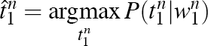
Road to HMMs
We want, out of all sequences of n tags t₁… t_{n}, the single tag sequence such that P(t₁… t_{n}|w₁… w_{n}) is highest.
­ That is, find the tag sequence t₁… t_{n} that maximizes the probability that sequence should tag the word sequence w₁… w_{n}
­ We use this notation:
Hat ^ means “our estimate of the best one”
Argmax_{x} P(x) means “the x such that P(x) is maximized”
3

Slide 37
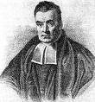
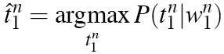
Road to HMMs
This equation (from the previous slide) is guaranteed to give us the best tag sequence
But how to make it operational? How to compute this value?
Intuition of Bayesian classification:
­ Use Bayes’ rule to transform into a set of other probabilities that are easier to compute
Thomas Bayes 1701–1761
4

Slide 38
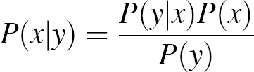
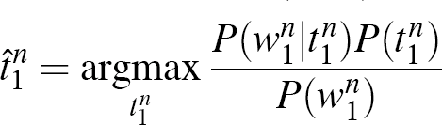
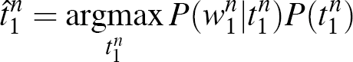
Using Bayes’ Rule
Bayes’ rule:
Apply Bayes’ rule:
Note that this is using the conditional probability, given a tag sequence, what is the most likely word sequence with those tags.
­ Eliminate the denominator, as it is the same for every sequence.
5

Slide 39
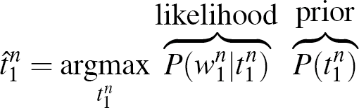
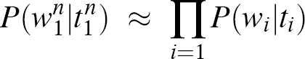
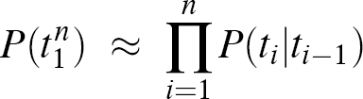
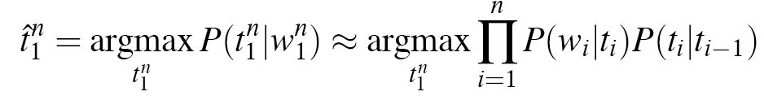
Likelihood and Prior
­ To further simplify. look at the two probabilities
­ Likelihood: Assume that the probability of the word depends only on its tag.
­ Prior: Make the bigram assumption that the tag only depends on the previous tag.
6

Slide 40
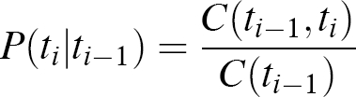
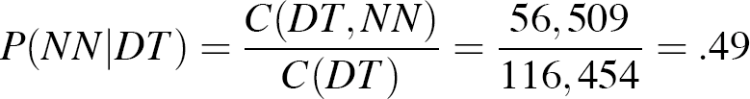
Two Sets of Probabilities (1)
Tag transition probabilities P(t_{i}|t_{i} – 1) (priors)
Given a tag t_{i} – 1, how likely is it that it is followed by t_{i}?
­ Determiners likely to precede adjectives and nouns
­ That/DT flight/NN and The/DT yellow/JJ hat/NN
­ So we expect P(NN|DT) and P(JJ|DT) to be high
­ Compute P(NN|DT) by counting in a labeled corpus:
Count of DT NN sequence
7

Slide 41
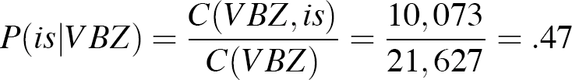
Two Sets of Probabilities (2)
Word likelihood probabilities P(w_{i}|t_{i})
Given a tag t_{i,} how likely is it that it is tagging word w_{i}
­ VBZ (3sg present verb) likely to be “is”
­ Compute P(is|VBZ) by counting in a labeled corpus:
Count of “is” tagged with VBZ
8

Slide 42
An Example: The Word “Race”
The word “race” can occur as a verb or as a noun.
­ Secretariat/NNP is/VBZ expected/VBN to/TO race/VB tomorrow/NR
­ People/NNS continue/VB to/TO inquire/VB the/DT reason/NN for/IN the/DT race/NN for/IN outer/JJ space/NN
How do we pick the right tag?
9

Slide 43
Disambiguating “Race”
Which tag sequence is most likely?
NNP
VBZ
VBN
TO
VB
NR
(a)
Secretariat
is
expected
to
race
tomorrow
NNP
VBZ
VBN
TO
NN
NR
(b)
Secretariat
is
expected
to
race
tomorrow
10

Slide 44
Example
The equations only differ in “to race tomorrow.”
The tag transition probabilities P(NN|TO) and P(VB|TO)
Lexical likelihoods from the Brown Corpus for “race” given a POS tag NN or VB
Tag sequence probability for how likely an adverb NR occurs given the previous tag verb VB or noun NN
P(NN|TO) = .00047
P(VB|TO) = .83
P(race|NN) = .00057
P(race|VB) = .00012
P(NR|VB) = .0027
P(NR|NN) = .0012
P(VB|TO)P(NR|VB)P(race|VB) = .00000027
P(NN|TO)P(NR|NN)P(race|NN) = .00000000032
So, we (correctly) choose the verb tag.
11

Slide 45
HMM Algorithm
We have seen an example of how the HMM algorithm can assign a tag, given the two sets of probabilities for the sequence of words.
We can compute the two sets of probabilities by counting frequencies in a corpus.
But what algorithm actually produces sequences of tags?
­ The optional lecture explains how an optimization algorithm, the Viterbi algorithm, finds the best tag sequences
12

Slide 46
Exercise 4.4.3
Download the POS document file: “Exercise 4_4_x.txt” from Week 4 Lectures
Part I: Computing Tag Transition Probabilities
Using the above referenced document as the tagged corpus, here is an example of how to compute some tag transition probabilities (from slide 13 in the lecture on POS tagging). We show the probability as the ratio of counts.
1: P(VB|TO) and P(NN|TO)
We count the number of occurrences of the tag TO, which is 4. Then out of those 4, something tagged TO is followed twice by a word tagged VB and once by a word tagged NN. So we get:
P(VB|TO) = Count (TO VB) / Count (TO) = 2 / 4
P(NN|TO) = Count (TO NN) / Count (TO) = 1 / 4
Choose one of the following pairs of tag transition probabilities and show the ratios:
2: P(IN|VBD) and P(DT|VBD)
3: P(NN|JJ) and P(JJ|JJ)
4: P(NN|DT) and 5: P(NN|IN)
Be prepared to share your results with the class.
13

Slide 47
Exercise 4.4.4
Download the POS document file: “Exercise 4_4_x.txt” from Week 4 Lectures
Part II: Computing Word Likelihood Probabilities
Using the above document as the tagged corpus, here is an example of how to compute some word likelihood probabilities (from slide 14 in the lecture on POS tagging). We show the probability as the ratio of counts.
1: P(is|VBZ) and P(has|VBZ)
We count the number of occurrences of the tag VBZ which is two. Then out of those two, neither of them is tagging the word “is” and one of them is tagging the word “has”. So we get:
P(is | VBZ) = Count ( VBZ, is) / Count (VBZ) = 0 / 2
P(has | VBZ) = Count ( VBZ, has) / Count(VBZ) = 1 / 2
Choose one of the following pairs of word likelihood probabilities and show the ratios:
2: P(moon|NN) and P(earth|NN)
3: P(small|JJ) and P(fragile|JJ)
4: P(one|CD) and P(six|CD)
5: P(Mr.|NNP) and P(Eagle|NNP)
Be prepared to share your results with the class.
14

Slide 48
POS Tagging: HMM Algorithm

Slide 49
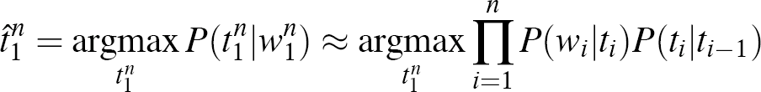
Hidden Markov Models
Recall that we estimated the best probable tag sequence for a given sequence of words as:
with the word likelihood x the tag transition (prior) probabilities.
When we evaluated the probabilities by hand for a sentence, we could pick the optimum tags.
But in general, we need an optimization algorithm to most efficiently pick the best tag sequence without computing all possible combinations of tag sequence probabilities.
What we’ve described with these two kinds of probabilities is a Hidden Markov Model (HMM).
­ The Markov Model is the sequence of words, and the hidden states are the POS tags for each word.
2

Slide 50
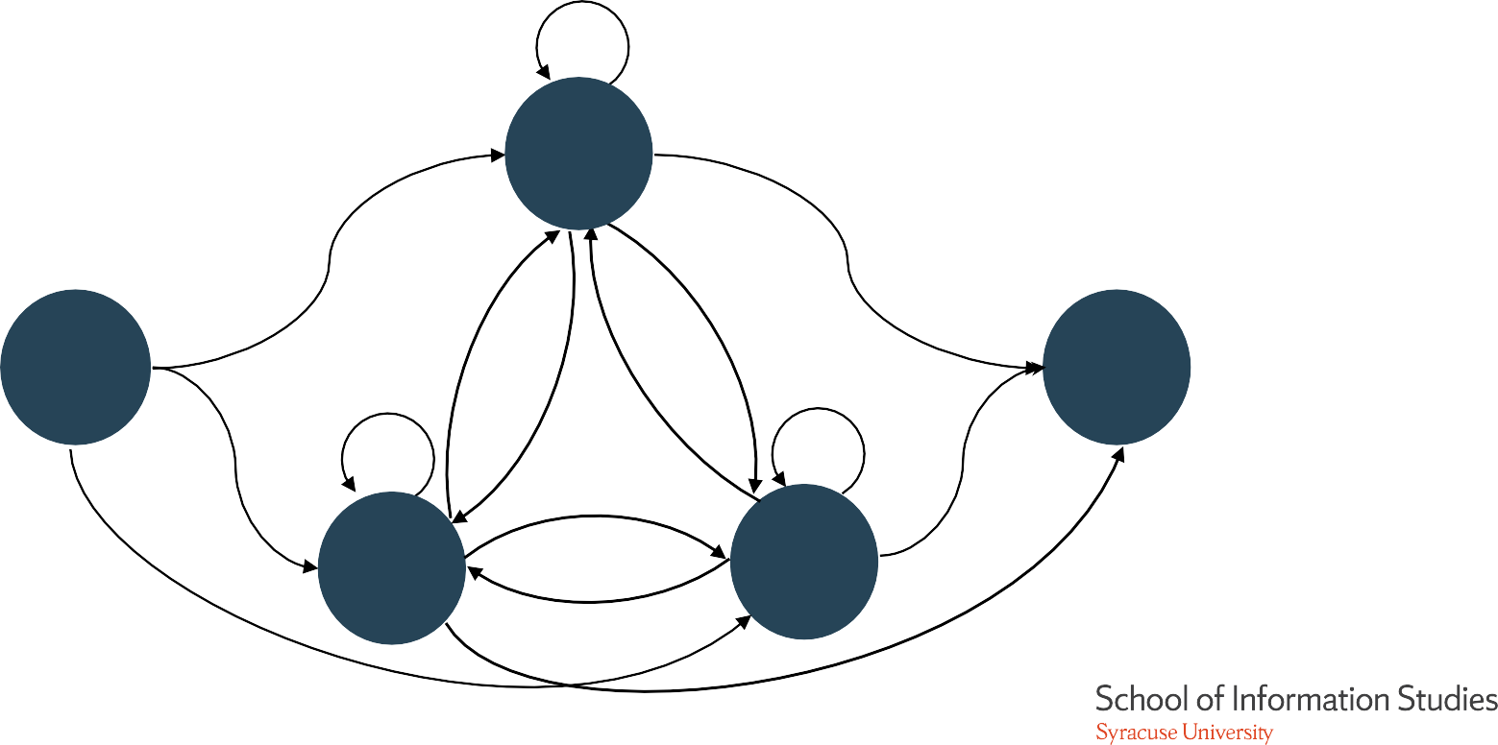
Tag Transition
Probabilities for HMM
The HMM hidden states, the POS tags, can be represented in a graph where the edges are the transition probabilities between POS tags.
a22
TO₂
a02
a24
a12
Start₀
a11
a33
END₄
a21
a01
a13
a34
VB₁
NN₃
a03
a14
3

Slide 51
Word Likelihoods for HMM
For each POS tag, give words with probabilities.
B₂
P(“aardvark” I TO)
…
P(“race” I TO)
…
P(“the” I TO)
…
P(“to” I TO)
…
P(“zebra” I TO)
TO₂
Start
0
End
4
VB₁
NN₃
B₁
P(“aardvark” I VB)
…
P(“race” I VB)
…
P(“the” I VB)
…
P(“to” I VB)
…
P(“zebra” I VB)
B₃
P(“aardvark” I NN)
…
P(“race” I NN)
…
P(“the” I NN)
…
P(“to” I NN)
…
P(“zebra” I NN)
4

Slide 52
The A Matrix for the POS HMM
Example of tag transition probabilities represented in a matrix, usually called the A matrix in an HMM:
­ The probability that VB follows <s> is .019,…
 | VB | TO | NN | PPSS
<s> | .019 | .0043 | .041 | .067
VB | .0038 | .035 | .047 | .0070
TO | .83 | 0 | .00047 | 0
NN | .0040 | .016 | .087 | .0045
PPSS | .23 | .00079 | .0012 | .00014
Figure 4.15. Tag transition probabilities (the a array, P(t_{i}|t_{i–1}) computed from the 87-tag Brown Corpus without smoothing. The rows are labeled with the conditioning events; thus P(PPSS|VB) is .0070. The symbol <s> is the start-of-sentence symbol.
From Jim Martin
5

Slide 53
The B Matrix for the POS HMM
Word likelihood probabilities are represented in a matrix, where for each tag, we show the probability that the tag on that word,
 | I | want | to | race
VB | 0 | .0093 | 0 | .00012
TO | 0 | 0 | .99 | 0
NN | 0 | .000054 | 0 | .00057
PPSS | .37 | 0 | 0 | 0
Figure 4.16. Observation likelihood (the b array) computed from the 87-tag Brown Corpus without smoothing.
From Jim Martin
6

Slide 54
Using HMMs for POS Tagging
From the tagged corpus, create a tagger by computing the two matrices of probabilities, A and B.
­ It is straightforward for bigram HMM, done by counting.
­ For higher-order HMMs, efficiently compute matrix by the forward–backward algorithm.
To apply the HMM tagger to unseen text, we must find the best sequence of transitions.
­ Given a sequence of words, find the sequence of states (POS tags) with the highest probabilities along the path.
­ This task is sometimes called “decoding.”
­ Use the Viterbi algorithm.
7

Slide 55
Viterbi Intuition: We Are Looking for the Best “Path”
Each word has states representing the possible POS tags.
S₁ S₂
S₃ S₄
RB
S₅
NN
VBN
JJ
DT
VB
TO
VBD
VB
back
NNP
the
NN
bill
promised
to
8

Slide 56
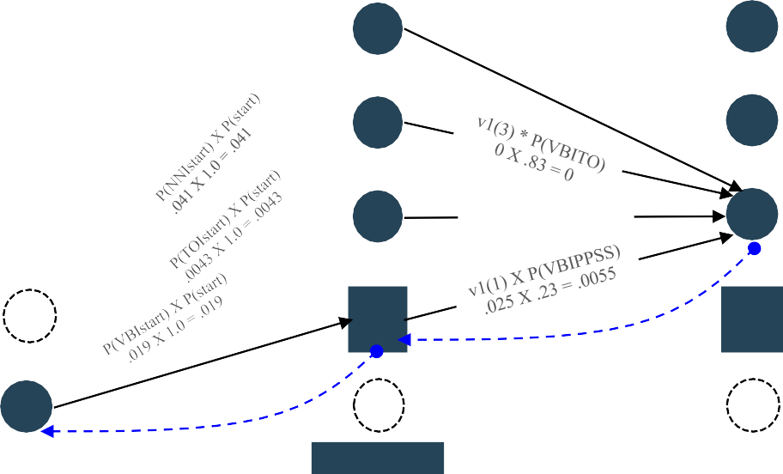
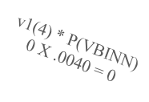
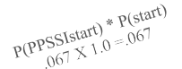
Viterbi Example
Each pair of tags labeled with an edge giving transition probability
Each tag in a state labeled with a Viterbi value giving maximum over states in previous word of: (its Viterbi value * transition probability * word likelihood), representing “best path to this node”
qend
end
end
end
end
end
end
v₁(4)= .041 X 0 =0
q4
NN
NN
NN
NN
NN
NN
v₁(3)= .0043 X 0 =0
q3
TO
TO
TO TO
v₂(2)= max(0,0,0,.0055) X .0093 = .000051
VB VB
TO
TO
v₁(2)= .019 X 0= 0
q2
VB
VB
v1(2) X P(VBIVB) 0 X .0038 = 0
VB
VB
v₁(1)= .067 X .37=.025
q1
PP SS
v0(0)= 1.0
PP SS
PP SS
PP SS
PP SS
PP SS
backtrace
q0
start
backtrace
start
start
start
start
start
i
O₁
want
to
race
From Jim Martin
O₂
t
O₃
O₄
9

Slide 57
Viterbi Algorithm Sketch
This algorithm fills in the elements of the array Viterbi in the previous slide (columns are words, rows are states (POS tags))
function Viterbi
for each state s, compute the initial column Viterbi[s, 1] = A[0, s] * B[s, word1]
for each word w from 2 to N (length of sequence) for each state s, compute the column for w
Viterbi[s, w] =
maximum over s’ (Viterbi[s’, w – 1] * A[s’, s] * B[s, w])
<save back pointer to trace final path> return the trace of back pointers
where A is the matrix of state transitions and B is the matrix of state/word likelihoods
10

Slide 58
POS Tagging:
Classifier

Slide 59
Recall HMM
So, an HMM POS tagger computes the tag transition probabilities (the A matrix) and word likelihood probabilities for each tag (the B matrix) from a (training) corpus.
Then, for each sentence that we want to tag, it uses the Viterbi algorithm to find the path of the best sequence of tags to fit that sentence.
­ Described in the optional lecture
This is an example of a sequential classifier. Let’s look at how this is related to a more traditional classifier, which we might call a feature- based classifier.
­ Classification task:
Given a word in a sentence, what is its POS tag?

Slide 60
Comparison of HMM
and Feature-Based Classifiers
Recall that HMM (and N-gram) taggers are sequential classifiers that use the previous sequence of tags as information.
word_{n–1} tag_{n–1}
… word_{–2} word_{–1} word
… tag_{–2} tag_{–1} XX
­ In the order from left to right, use information from previous tags (tag prior probabilities) and word (word likelihood probabilities) to predict the next tag in the sequence.
Instead, a feature-based classifier is looking just at the word and properties/features of the surrounding words.
word_{–2} word_{–1} word word₊₁ word₊₂
XX
­ Assign a tag XX to the word.

Slide 61
How Can We Improve Our Tagger?
What are the main sources of information for our HMM POS tagger?
­ Knowledge of tags of neighboring words
­ Knowledge of word tag probabilities
­ man is rarely used as a verb
Unknown words (words not occurring in the training corpus) can be a problem because we don’t have this information.
And we are not including information about the features of the words themselves.

Slide 62
Feature-Based Classifiers
A feature-based classifier is an algorithm that will take a word and assign a POS tag based on features of the word in its context in the sentence.
Many algorithms are used for these traditional classifiers. Just to name a few:
­ Naïve Bayes, Maximum entropy (MaxEnt), Support vector machines (SVM)
­ We’ll be covering a lot more about classifiers later in the course

Slide 63
Features of Words
Can do surprisingly well just looking at a word by itself:
­ Word
­ Lowercased word
­ Prefixes
­ Suffixes
the: the ® DT (determiner)
Importantly: importantly ® RB (adverb) unfathomable: un- ® JJ (adjective)
Importantly: -ly ® RB tangential: -al ® JJ
Meridian: CAP ® NNP (proper noun) 35-year: d-x ® JJ
­ Capitalization
­ Word shapes
These properties can include information about the previous or the next word(s)
­ The word be appears to the left pretty ® JJ
But not information about tags of the previous or next words, unlike HMM

Slide 64
Development Process for Features
The tagged data should be separated into a training set and a test set.
­ The classifier is trained on the training set, which produces a “tagger”
­ And evaluated on the test set, by applying the tagger to every word and comparing the predicted tag with the answer in the test set
­ May also hold out some data for development
­ Evaluation numbers are not prejudiced by the training set

Slide 65
Development Process for Features
If our feature-based tagger has errors, then we improve the features.
­ Suppose we incorrectly tag as as IN in the phrase as soon as, when it should be RB:
PRP VBD IN RB IN PRP VBD.
They left as soon as he arrived.
­ We could fix this with a feature that includes the next word.

Slide 66
POS Tagging: Evaluation and Demos

Slide 67
Evaluation:
Is Our POS Tagger Any Good?
Answer: We use a manually tagged corpus, which we will call the “gold standard.”
­ We run our POS tagger on the gold standard and compare its predicted tags with the gold tags.
­ We compute the accuracy (and other evaluation measures). Important: 100% is impossible, even for human annotators.
­ We estimate that humans can do POS tagging at about 98% accuracy (by comparing humans with each other).
­ Some tagging decisions are very subtle and hard to do.
­ Mrs/NNP Shaefer/NNP never/RB got/VBD around/RP to/TO joining/VBG
­ All/DT we/PRP gotta/VBN do/VB is/VBZ go/VB around/IN the/DT corner/NN
­ Chateau/NNP Petrus/NNP costs/VBZ around/RB 250/CD
­ The “gold standard” will have human mistakes; humans are subject to fatigue etc.

Slide 68
Overview of POS Tagger Accuracy
Stanford NLP group performed experiments with different tagging techniques and looked at the improvements.
Techniques
­ Most frequent tag:
­ Trigram HMM:
­ HMM with trigrams
­ MaxEnt P(t|w):
­ Feature-based tagger
­ MEMM tagger:
accuracies of all words/unknown words
~90% / ~50%
~95%/~55%
Most errors on unknown words
93.7%/82.6%
96.9%/86.9%
­ Combines feature based and HMM tagger
­ Bidirectional dependencies:
97.2%/90.0%
­ Upper bound:
* Results from slides by Chris Manning
~98% (human agreement)

Slide 69
POS Taggers With Online Demos
There are not too many online taggers available for demos, but here are some possibilities:
­ The Stanford online parser demo includes POS tags: http://nlp.stanford.edu:8080/parser/ http://nlp.stanford.edu:8080/corenlp/
­ Illinois (UIUC) tagger demo from the Cognitive Computation Group
­ http://cogcomp.cs.illinois.edu/demo/pos/?id=4 (colors!)

Slide 70
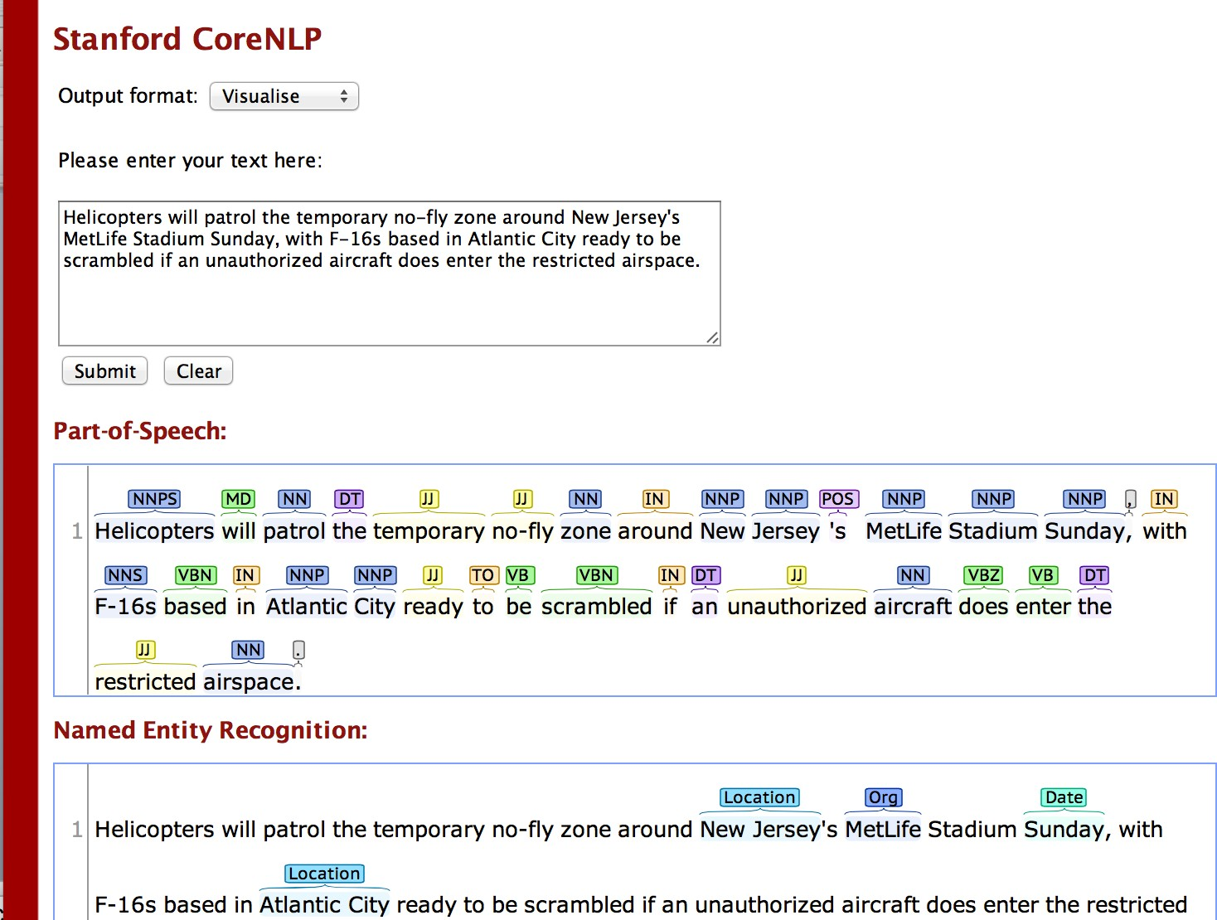
Stanford NLP Demo

Slide 71
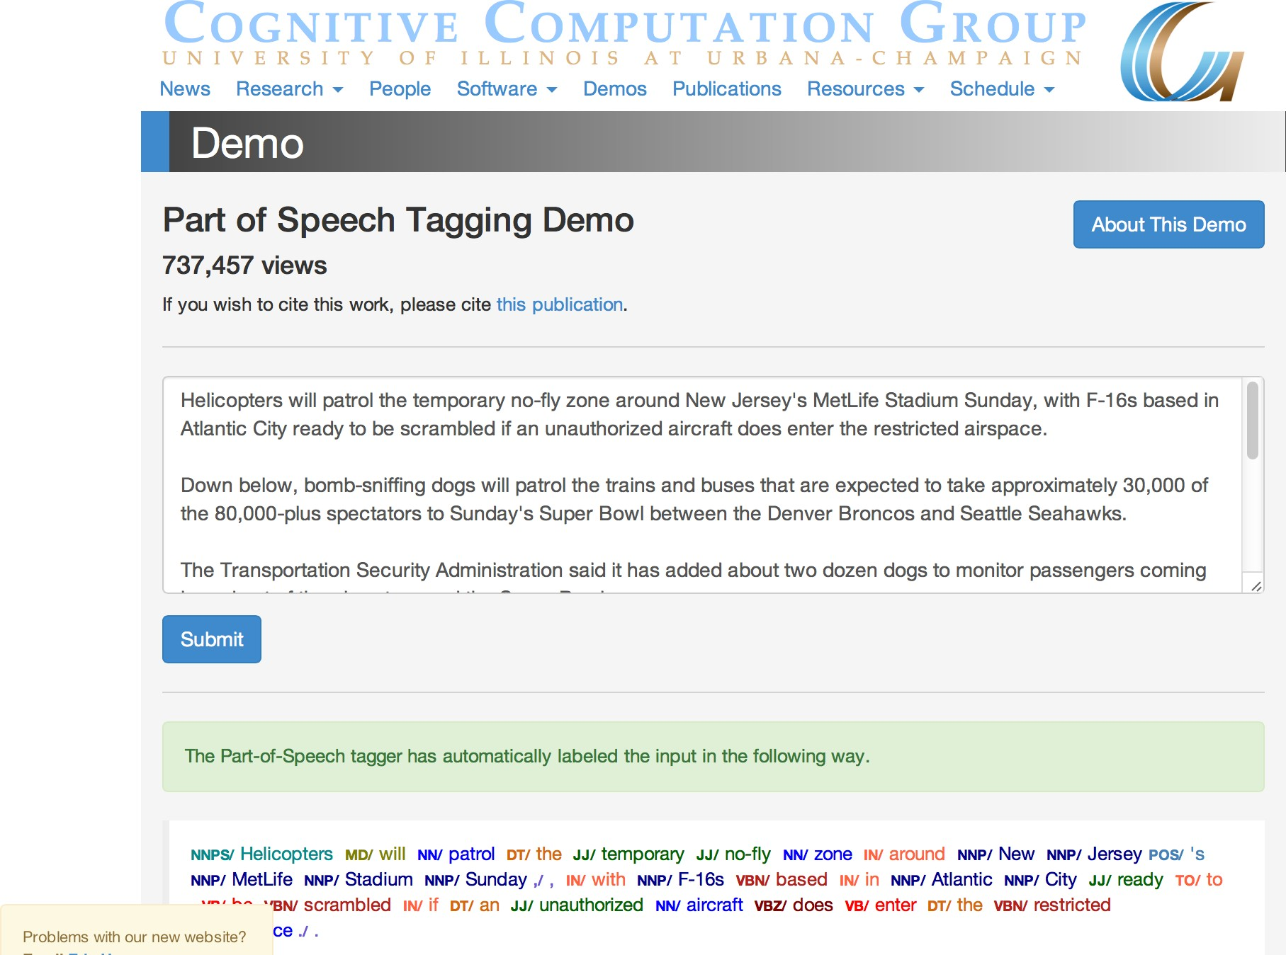
UIUC Demo

Slide 72
Conclusions
Part-of-speech tagging is a doable task with high-performance results.
­ In addition to the standard text POS taggers discussed here, there are now POS tag systems and taggers developed for social media text.
It contributes to many practical, real-world NLP applications and is now used as a pre-processing module in most systems.
Computational techniques learned at this level can be applied to NLP tasks at higher levels of language processing.

Slide 73
Classification Introduction

Slide 74
Classification: Definition
Given a collection of examples (training set):
­ Each example is represented by a set of features, sometimes called attributes
­ Each example is to be given a label or class
Find a model for the label as a function of the values of features.
Goal: Use the model to assign labels to previously unseen examples as accurately as possible.
A test set is used to determine the accuracy of the model.
­ Usually, the given data set is divided into training and test sets, with training set used to build the model and test set used to validate it.

Slide 75
Supervised vs.
Unsupervised Learning
Supervised learning (classification and other tasks)
­ Supervision: the training data (observations, measurements, etc.) are accompanied by labels indicating the class of the observations
­ New data are classified based on the training set
Unsupervised learning (includes clustering)
­ The class labels of training data are unknown
­ Given a set of measurements, observations, etc. with the aim of establishing the existence of classes or clusters in the data

Slide 76
NLP Tasks
Many NLP tasks can be accomplished either through:
­ Rule-based or symbolic techniques, such as using RegExp
­ Supervised techniques, where the task is defined automatically from a training set
In both cases, the evaluation of the task will most likely use a training set to define the technique and a test set for evaluation.
­ POS tagging uses Hidden Markov Models
­ Parsing uses statistical lexicalized parsers
­ Sentiment analysis uses classification
The evaluation of these tasks often uses ideas from the evaluation of classification.

Slide 77
Illustrating Classification Tasks
Tid | Attrib1 | Attrib2 | Attrib3 | Class
1 | Yes | Large | 125K | No
2 | No | Medium | 100K | No
3 | No | Small | 70K | No
4 | Yes | Medium | 120K | No
5 | No | Large | 95K | Yes
6 | No | Medium | 60K | No
7 | Yes | Large | 220K | No
8 | No | Small | 85K | Yes
9 | No | Medium | 75K | No
10 | No | Small | 90K | Yes
Learning algorithm
Induction
Learn model
Model
Model
Model
Training Set
Apply model
Tid | Attrib1 | Attrib2 | Attrib3 | Class
11 | No | Small | 55K | ?
12 | Yes | Medium | 80K | ?
13 | Yes | Large | 110K | ?
14 | No | Small | 95K | ?
15 | No | Large | 67K | ?
Deduction
Test Set
SCHOOL OF INFORMATION STUDIES | SYRACUSE UNIVERSITY
5

Slide 78
Classification Techniques
There are a number of different classification algorithms to build a model for classification.
­ Decision-tree methods, Rule-based methods, Memory-based reasoning, instance-based learning, Neural networks, Genetic algorithms, Naïve Bayes and Bayesian belief networks, Support vector machines
In this introduction, we illustrate classification tasks using decision-tree methods.
Features can have numeric values (continuous) or a finite set of values (categorical/nominal), including Boolean true/false.

Slide 79

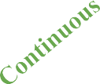
Example of a Decision Tree
Tid | Refund | Marital Status | Taxable Income | Cheat
1 | Yes | Single | 125K | No
2 | No | Married | 100K | No
3 | No | Single | 70K | No
4 | Yes | Married | 120K | No
5 | No | Divorced | 95K | Yes
6 | No | Married | 60K | No
7 | Yes | Divorced | 220K | No
8 | No | Single | 85K | Yes
9 | No | Married | 75K | No
10 | No | Single | 90K | Yes
Refund
Yes
No
No
MarSt
Single, Divorced
Married
No
TaxInc
<80K
>80K
No
Yes
Training Data
Model: Decision Tree
Example task: Given the marital status (MarSt), refund status, and taxable income (TaxInc) of a person, label them as to whether they will cheat on their income tax.

Slide 80

Another Example of Decision Tree
Single, Divorced
Tid | Refund | Marital Status | Taxable Income | Cheat
1 | Yes | Single | 125K | No
2 | No | Married | 100K | No
3 | No | Single | 70K | No
4 | Yes | Married | 120K | No
5 | No | Divorced | 95K | Yes
6 | No | Married | 60K | No
7 | Yes | Divorced | 220K | No
8 | No | Single | 85K | Yes
9 | No | Married | 75K | No
10 | No | Single | 90K | Yes
MarSt
Married
No
Refund
Yes
No
>80K
No
TaxInc
<80K
No
Yes
There could be more than one tree that fits the same data!

Slide 81
Decision-Tree Classification Task
Tid | Attrib1 | Attrib2 | Attrib3 | Class
1 | Yes | Large | 125K | No
2 | No | Medium | 100K | No
3 | No | Small | 70K | No
4 | Yes | Medium | 120K | No
5 | No | Large | 95K | Yes
6 | No | Medium | 60K | No
7 | Yes | Large | 220K | No
8 | No | Small | 85K | Yes
9 | No | Medium | 75K | No
10 | No | Small | 90K | Yes
Tree- induction algorithm
Induction
Learn model
Model
Decision tree
Model
Model
Training Set
Apply model
Tid | Attrib1 | Attrib2 | Attrib3 | Class
11 | No | Small | 55K | ?
12 | Yes | Medium | 80K | ?
13 | Yes | Large | 110K | ?
14 | No | Small | 95K | ?
15 | No | Large | 67K | ?
Deduction
Test Set
SCHOOL OF INFORMATION STUDIES | SYRACUSE UNIVERSITY
9

Slide 82
Apply Model to Test Data
Test Data
Refund | Marital Status | Taxable Income | Cheat
No | Married | 80K | ?
Refund
Yes
No
No
MarSt
Single, Divorced
Married
Assign cheat to “No”
TaxInc
No
<80K
>80K
No
Yes
SCHOOL OF INFORMATION STUDIES | SYRACUSE UNIVERSITY
10

Slide 83
Classification Evaluation

Slide 84
Confusion Matrix
Focus on the predictive capability of a model on test set
­ Compare the known actual class with the predicted class
Confusion matrix for a binary classifier (two labels) on test set:
 | Predicted Class
Actual Class |  | Class = Yes | Class = No
 | Class = Yes | a | b
 | Class = No | c | d
a: TP (true positive) b: FN (false negative) c: FP (false positive) d: TN (true negative)

Slide 85
Classifier Evaluation Measures
Confusion matrix:
 | Yes - C₁ | No - C₂
Yes - C₁ | a: True positive | b: False negative
No - C₂ | c: False positive | d: True negative
_{Accuracy =} a + d ₌ TP + TN a + b + c + d TP + TN + FP + FN
Precision = TP/(TP + FP),
percent correct out of all predicted Yes Recall = TP/(TP + FN),
percent correct out of all actual Yes
F-measure = 2 * (Recall * Precision)/(Recall + Precision)

Slide 86
Accuracy Example
Suppose that we are predicting whether or not someone will buy a computer.
­ Evaluating accuracy with a test set of 10,000 people
Classes | buy_computer = yes | buy_computer = no | Total
buy_computer = yes | 6,954 | 46 | 7000
buy_computer = no | 412 | 2,588 | 3000
total | 7,366 | 2,634 | 10000
_{Accuracy =} a + d ₌ TP + TN a + b + c + d TP + TN + FP + FN
Accuracy = 6,954 + 2,588/10,000 = 95.42%

Slide 87
Multi-Class Classification
Many classification algorithms solve binary classification tasks, while many tasks are naturally multi-class (i.e., there are more than two labels).
Multi-class problems are solved by training a number of binary classifiers and combining them to get a multi-class result.
The confusion matrix is extended to the multi-class case.
The accuracy definition is naturally extended to the multi-class case.
Precision and recall are defined for the binary classifiers trained for each label.

Slide 88
Issues With Imbalanced Classes
Consider a two-class problem with labels Yes and No.
­ Number of No examples = 990
­ Number of Yes examples = 10
If the model predicts everything to be No, accuracy is 990/1,000 = 99%.
­ Accuracy is misleading because the model does not detect any Yes examples.
­ Precision and recall will be better measures if you are training a classifier to find rare examples.

Slide 89
Classifier Evaluation Methods
Holdout method
­ Given data are randomly partitioned into two independent sets:
­ Training set (e.g., 2/3) for model construction
­ Test set (e.g., 1/3) for accuracy estimation
Cross-validation (k – fold, where k = 10 is most popular)
­ Randomly partition the data into k mutually exclusive subsets, each approximately equal size
­ At i –th iteration, use Di as test set and others as training set
1:
2:
. . .
test | train | train | train | train
train | test | train | train | train

Slide 90
Lab Session – Week 4: POS Tagging in the NLTK
Lab Session - Week 4 Homework
Lab Instructions:
Download the Lab files located on BB in the folder: Lectures - Week 4.
labweek4.postags.txt
lab1.postag_corpora.doc
lab2.taggersetup.doc
lab3.gramtagger.doc
lab4.taggingtext.doc
For this lab session, use the file“labweek4.postags.txt“ to copy/paste the Python examples as you try them out.
Choose a corpus from any of the NLTK books or Gutenberg. Tokenize the corpus and run a POS tagger, either the Bigram tagger t2 that we defined in lab [lab1-lab4], or the Stanford tagger (nltk.pos_tag), on the tokens.
Compute the frequencies of the POS tags and classes of POS tags from your corpus. Note that you should do the processing steps from the last section of the lab: split the raw text into sentences, tokenize the list of sentences then run the tagger on the list of sentences, where the result is a list of lists of (word, tag) pairs, flatten the list to get just one list of (word, tag), put either the tags or the first letter of the tags into a Frequency Distribution, print and report the results as done in the first section of the lab.
Homework:
Submit a report summary that includes the corpus name, tokenizer, POS tagger and frequencies of the tags or classes of tags. Note any significant differences in the frequent tags and tag classes between your corpus and the Penn Treebank tags that you ran in the first part of the lab. Include any observations and lessons learned in your report. In addition to the report summary, upload a copy of the python code you developed as part of this lab.

